Slide 1
INTRODUCTORY CLASS ON GEOGRAPHICAL THOUGHT ( 6TH SEM. GEOA)
RITABRATA MUKHOPADHYAY, ASSOCIATE PROFESSOR OF GEOGRAPHY, DEPT. OF GEOGRAPHY, AHFSM, DOMJUR , HOWRAH ( Date & time of online class: 17.04.2021{ 12.30pm-1.30pm)

Slide 2
WHAT IS GEOGRAPHICAL THOUGHT?
A. DESCRIPTION OF EARTH BOUND PHENOMENA.
B. BASIC QUESTIONS OF GEOGRAPHY-
1Where? 2. Why? 3. What? 4. How ? 5. So what ? 6. What is spatial distribution ?
C. ACCURATE, ORDERLY AND RATIONAL DESCRIPTION AND INTERPRETATION OF THE VARIABLE CHARACTER OF THE EARTH SURFACE.
D. GEOCRATIC TYPE OF GEOGRAPHY.
E. THEOCRATIC TYPE OF GEOGRAPHY.
F. WE-OCRATIC TYPE OF GEOGRAPHY.

Slide 3
FUNDAMENTAL CONCEPTS OF GEOGRAPHICAL THOUGHT
1. EARTH SURFACE.
2. AREAL DIFFERENTIATION
3. THE REGION.
4. LOCATION.
5. TIME.
6.CAUSE AND EFFECT.
7. SEQUENT OCCUPANCE.
8. SPATIAL DISTRIBUTION.
9. SPATIAL INTERACTION.
10 GEOGRAPHY AS AN EMPIRICAL SCIENCE.
11. SYNTHESIS.
12.UNITY OF NATURE.

Slide 4
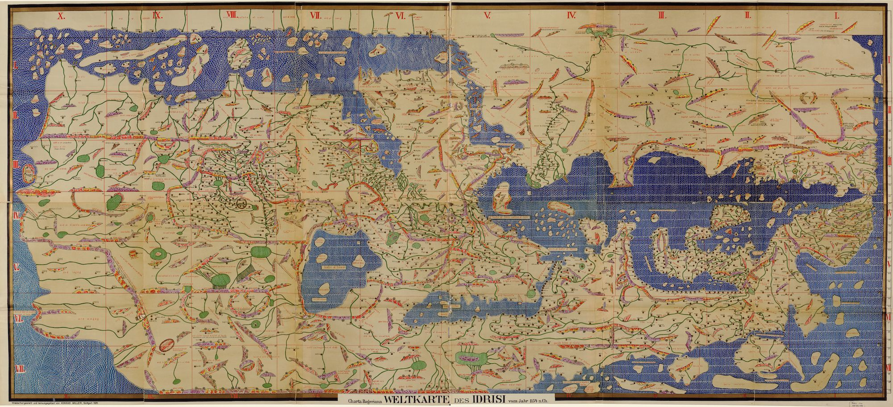
RELATIONS WITH OTHER SCIENCES
1. ASTRONOMY.
2. GEOLOGY.
3. PHYSICS.
4. BOTANY.
ECOLOGY
MAP OF AL-IDRISI

Slide 5
RELATIONS WITH SOCIAL SCIENCES & HUMANITIES
1. ECONOMICS.
2. SOCIOLOGY.
3. ANTHROPOLOGY. HISTORY.
4. CULTURAL STUDIES.
5. LITERATURE.
6. PHILOSOPHY.
7. RELIGIOUS STUDIES.
8. CRITICAL STUDIES.
9. POST MORDERN CONCEPTS
PHOTOGRAPH OF MICHEL-
-DEAR, POST MODERN-
-GEOGRAPHER

Slide 6
MAJOR SCHOOLS OF GEOGRAPHICAL THOUGHT
A. GERMAN SCHOOL OF GANZHIET, CHROLOGY AND LANDSHAFTSKURTDE.
B. FRENCH SCHOOL OF “LA GEOGRAPHIE HUMAINE”.
C. BRITISH SCHOOL OF REGIONAL STUDIES.
D. RUSSIAN SCHOOL OF LANDSCAPE SCIENCE.
E. AMERICAL SCHOOL OF SPATIAL SCIENCE AND HUMAN GEOGRAPHY.
F. MODERN INDIAN GEOGRAPHICAL THOUGHT.

Slide 7
EVOLUTION OF GERMAN GEOGRAPHICAL THOUGHTS
A. 1ST PHASE OF CLASSICAL PERIOD OF GERMAN GEOGRAPHICAL THOUGHT ( CONTRIBUTIONS OF IMMANUEL KANT & VARENIUS).
B. 2ND PHASE OF CLASSICAL PERIOD OF GERMAN GEOGRAPHICAL THOUGHT ( CONTRIBUTIONS OF ALEXANDER VON HUMBOLDT & CARL RITTER ).
C. MODERN GEOGRAPHICAL THOUGHT OF GERMANY.

Slide 8
CONTRIBUTION OF ALEXANDER VON HUMBOLDT(1769-1859)
TOPIC OF DISCUSSION
A. LIFE AND WORKS .
B. GEOGRAPHICAL EXPEDITIONS
C. PUBLICATIONS OF RESULTS OF AMERICAN EXPEDITIONS.
D. RUSSIAN EXPEDITIONS AND GENERALIZATIONS.
E.GEOGRAPHICAL CONCEPT OF HUMBOLDT.
F. THE CONCEPT OF “ COSMOS”.
G.SYSTEMATIC GEOGRAPHY.
H. REGIONAL GEOGRAPHY.
I. OVERALL CONTRIBUTION.

Slide 9
A. LIFE AND WORKS( PHOTOGRAPH OF A. HUMBOLDT)

Slide 10
B. EXPEDITIONS TO AMERICA
1ST PHASE OF EXPEDITIONS- FIRST AT VENEZUELA THEN FOUND LAKE VALENCIA IN 1800.
2ND PHASE- NORTHERN AMAZON BASIN.
3RD PHASE –MAPPING OF ORINIO RIVER.
4TH PHASE- VISITING ANDEAN AMAZON REGION.
5TH PHASE- VISITING VOLCANOS OF ECUADOR IN 1802.
6TH PHASE- AT CUBA IN 1804.
7TH PHASE- USA IN LATER PERIOD OF 1804.

Slide 11
C. PUBLICATIONS OF RESULTS OF AMERICAN EXPEDITIONS
A. TOPICS OF PUBLICATIONS-
1. NEW MAPPING OF VISITED AREAS.
2. CAREFUL SCIENTIFIC INVESTIGATION ON INTER RELATIONSHIP BETWEEN PHYSICAL GEOGRAPHY, ECOLOGY AND SPACE OF VISITED PLACES.
3. CONTRIBUTIONS ON BIO-GEOGRAPHY.
4. ESTABLISH RELATIONSHIP BETWEEN RATIONAL UTILIZATION OF NATURAL RESOURCES WITH ECONOMIC PROSPERITY.
B. MAIN ARTICLES:
1. “VOYAGE AUX REGIONS EQUINOXIALES DU NOUVEAU CONTINENT”. (1816)
2. “ RELATION HISTORIQUE”( 1818-1819)

Slide 12
D. RUSSIAN EXPEDITION AND GENERALIZATIONS
A. 1ST PHASE- VISIT TO ST. PETERSBURG AND OMSK.
B. 2ND PHASE- VISIT TO SIBERIA
MAIN OBSERVATIONS AFTER EXPEDITION
1. CONSTRUCTION OF FIRST WORLD MAP ON THE BASIS OF TEMPERATURE USING ISOTHERMS .
2. DEVELOPMENT OF THEORITICAL FRAMEWORK OF CLIMATIC CLASSIFICATIONS.
3. INTRODUCTION OF TERM “ CLIMATOLOGY”.

Slide 13
E.GEOGRAPHICAL CONCEPTS OF HUMBOLDT
1. “ HARMONIOUS UNITY OF COSMOS” ( INFLUNCE OF GOETHE AND J.C.F.VON SCHILLER) = HARMONIOUS UNITY IN NATURE.
2.CONCEPT OF “PHYSIOGRAPHIA”.
3. CLASSIFICATION OF “COSMOGRAPHY” = a) Uranography, b) Geography.
4. “IDEA OF UNITY OF HUMAN RACE”.
5. CONCEPT OF UNITY IN NATURE PRESUMED A CASUAL INTERRELATIONS OF ALL THE INDIVIDUAL FEATURES IN NATURE.
6. UNITY IN THE RELATIONSHIP BETWEEN ORGANIC LIFE WITH INORGANIC SURFACE.
7. CONCEPT OF “ LANDSCHAFT” & “ ROMANTIC” MOVEMENT.
8. VALUE OF “COMPERATIVE GEOGRAPHY”.

Slide 14
F. “ THE COSMOS”
A. HUMBOLDT WOULD BE KNOWN FOR HIS BOOK “COSMOS” ( FIVE VOLUMES-1845-1858).
THE PHILOSOPHY OF “COSMOS”
1. PHYSICAL DESCRIPTION OF WORLD AS A SPECIAL & SEPARATE DISCIPLINE.
2. EMPIRICAL ASPECTS OF NATURE”S ENTITY.
3. THE ACTION OF NATURE STUDIES THROUGH MEDIA SUCH AS TRAVEL DESCRIPTIONS, POETRY, LANDSCAPE PAINTING & COMPARATIVE PLANT STUDIES.
4. HISTORY OF NATURAL PHILOSOPHY.

Slide 15
G. CONCEPT OF SYSTEMATIC GEOGRAPHY
HUMBOLDT CATEGORISED THE KNOWLEDGE OF NATURAL OR PHYSICAL PHENOMENA IN TO THREE GROUPS :
1. SYSTEMATIC SCIENCE ( BOTANY, ZOOLOGY AND GEOLOGY OF SPACE ).
2. HISTORICAL SCIENCES ( HISTORY OF THE DEVELOPMENT OF ANIMALS, PLANTS & ROCKS ).
3. GEOGRAPHY OR EARTH SCIENCE OR ERDKUNDE OR PHYSICAL GEOGRAPHY.

Slide 16
H. CONCEPT OF REGIONAL GEOGRAPHY
WORKS OF HUMBOLDT ON REGIONAL GEOGRAPHY- 1. “ESSAI POLITIQUE SUR LE ROYAUME DE LA NOUVELLE ESPAGNE”, 2. ESSAI POLITIQUE SUR I ILE DE CUBA”.
CONCEPT OF REGIONAL GEOGRAPHY
1. INTERDEPENDENCE OF AREAL PHENOMENA.
2. HUMAN FACTORS APPEARED TO BE SUBORDINATED TO THE NATURAL FACTORS . ( SUDEEDTA ADHIKARI)

Slide 17
I. METHODS AND APPROACHES
1. EXTENSIVE FIELD WORKS.
2. GEOGRAPHICAL EXPEDITIONS.
3. EMPIRICAL METHODS OF RESEARCH.
4. INDUCTIVE APPROACH.

Slide 18
INSTRUMENTS OF GEOGRAPHICAL EXPEDITION BY HUMBOLDT

Slide 19
INSTRUMENTS OF GEOGRAPHICAL EXPEDITION BY HUMBOLDT(02)

Slide 20
CONTRIBUTIONS OF HUMBOLDT
1. HUMBOLDT”S VIEW OF GEOGRAPHY AS A SCIENCE.
2. CONCEPT OF “GEOGNOSIA”.
3. SYSTEMATIC EPISTEMOLOGY OF GEOGRAPHY.
4. ASTHETIC SATISFACTION.
5. CONCEPT OF INTERDEPENDENT UNITY IN NATURE (“ ZUSAMMENHANG”).
6. GEOGRAPHY AS “DISTINCTIVE SCIENCE”.
7. EMPIRICAL AND INDUCTIVE METHOD.
8. HUMBOLDT IS REGARDED AS THE FATHER OF SYSTEMATIC PHYSICAL GEOGRAPHY.

Slide 21
THANK YOU

